Slide 1
Entity Relationship Modeling
(& Normalization)
S511 Session 5, IU-SLIS

Slide 2
Outline
Data Modeling: Big picture
E-R Model
  Attributes
    types
  Relationships
    connectivity, cardinality
    strength, participation, degree
  Entities
    composite entity
    supertype/subtype
Table Normalization
  normal forms
    1NF, 2NF, 3NF
S511 Session 5, IU-SLIS

Slide 3
S511 RDB Project Lifecycle
Study Database Environment
↓
Define Database Objectives
Planning
&
Analysis
Implementation
Design
Realize data model in DBMS
(tables, forms, queries, reports)
↓
Populate database
↓
Test, Debug, & Evaluate
Data Analysis & Requirements
↓
Data Modeling & Verification
S511 Session 5, IU-SLIS
Notes:
data analysis
- what data is available
- what information is needed
- how to transform given data to desired info?
-- identify queries & processes
data modeling
- identify entities, attributes, relationships
- draw E-R diagram
- normalize to reduce data redundancies
verification
- will the model support processes that can satisfy database objectives?

Slide 4
Basic Modeling Concepts
Model
  “Description or analogy used to visualize something that cannot be directly observed”
  -Webster’s Dictionary -
Data Models
  Relatively simple representation of complex real-world data structures
  Facilitate communication & enhance understanding
  Degrees of data abstraction
    Conceptual Model
      global view of data
    Internal Model
      DBMS view of data
    External Model
      end-user view of data
    Physical Model
      machine view of data
S511 Session 5, IU-SLIS

Slide 5
Degrees of Data Abstraction
Conceptual
  Global view of data
    identify and describe main data items
    e.g. E-R diagram
  Hardware and software independent
Internal
  Representation of database as seen by DBMS
    adapt conceptual model to specific DBMS
    e.g. Access tables
  Software dependent
External
  Users’ views of data environment
    group requirements & constraints subsets into functional modules
    e.g. student registration module, class scheduling module
  Facilitates development & revalidates the conceptual model
Physical
  Lowest level of abstraction
    determine of physical storage devices and access methods
  software and hardware dependent
S511 Session 5, IU-SLIS

Slide 6
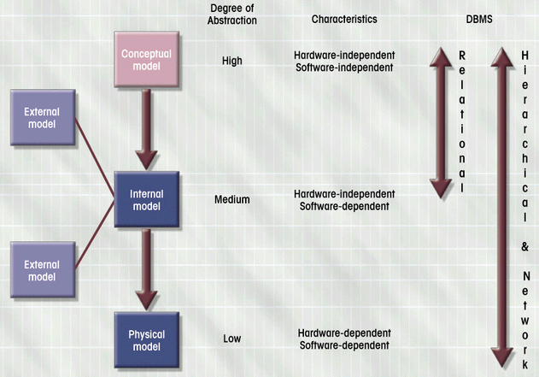
Data Abstraction Models
Database Systems: Design, Implementation, & Management: Rob & Coronel
S511 Session 5, IU-SLIS

Slide 7
Entity Relationship Model
Main components of the ER Model
  Entities
    entity set (table)
    entity name (noun) is usually written in capital letters
  Attributes
    characteristics of entities
    attribute domain = set of possible values
  Relationships
    association between entities
Entity Relationship Diagram (ERD)
  ER model forms the basis of an ER diagram
  ERD represents the conceptual view of the database
S511 Session 5, IU-SLIS

Slide 8
E-R Model: Attributes
Simple
  Cannot be subdivided
    e.g. age, sex, marital status
Composite
  Can be subdivided into additional attributes
    e.g. address  street, city, zip
  Replace with multiple simple attributes
Single-valued
  Can have only a single value
    e.g. ssn ← person has one social security number
Multi-valued
  Can have many values
    e.g. college degree ← person may have several college degrees
  Avoid if possible
Derived
  Can be derived with algorithm
    e.g. age = (current date - date of birth)/365
  Stored vs. Computed
    store to save CPU cycles & keep track of historical data
    compute to save storage & use current data
S511 Session 5, IU-SLIS

Slide 9
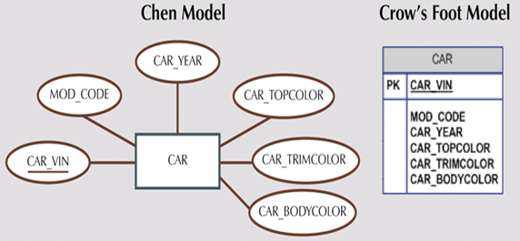
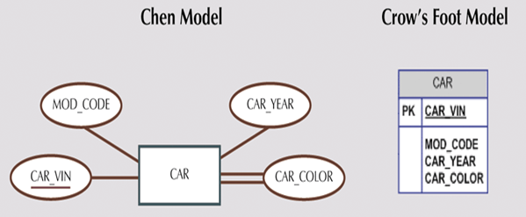
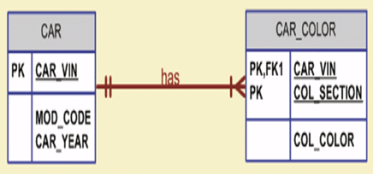
E-R Model: Attributes
Multi-valued attributes
  Replace with multiple single-valued attributes.
    Car_Color  Car_TopColor, Car_TrimColor, Car_BodyColor, Car_InteriorColor
    could be problematic
  Create a new entity composed of original multi-valued attribute’s components
    Car_Color  CAR_COLOR (Car_Vin, Col_Section, Col_Color)
Database Systems: Design, Implementation, & Management: Rob & Coronel
S511 Session 5, IU-SLIS

Slide 10
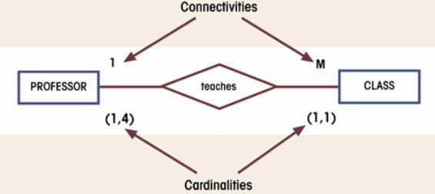
E-R Model: Relationships
Relationship = Association between entities
  Connectivity & Cardinality are established by business rules.
Connectivity
  Type/Classification of Relationships
  1:1, 1:M, M:N
Cardinality
  (min, max) = minimum/maximum number of occurrences of the related entity
Database Systems: Design, Implementation, & Management: Rob & Coronel
S511 Session 5, IU-SLIS

Slide 11
Relationship Strengths
Existence Dependence
  Entity’s existence depends on the existence of related entities.
    Existence-independent entities can exist apart from related entities.
  e.g. EMPLOYEE claims DEPENDENT
    A dependent cannot exist without an employee.
      DEPENDENT is existence-dependent on EMPLOYEE.
Weak (non-identifying) Relationship
  PK of related entity does not contain PK component of parent entity
    One entity is existence-independent on another.
  e.g. COURSE (CRS_CODE, DEPT_CODE, CRS_DESCRIPTION, CRS_CREDIT)
  CLASS (CLASS_CODE, CRS_CODE, CLASS_SECT, CLASS_TIME, …)
Strong (identifying) Relationship
  PK of related entity contains PK component of parent entity
    One entity is existence-dependent on another
  e.g. COURSE(CRS_CODE, DEPT_CODE, CRS_DESCRIPTION, CRS_CREDIT)
  CLASS(CRS_CODE, CLASS_SECT, CLASS_TIME, …)
S511 Session 5, IU-SLIS

Slide 12
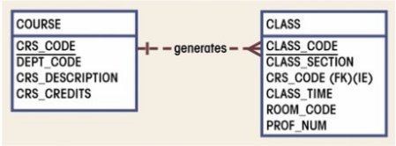
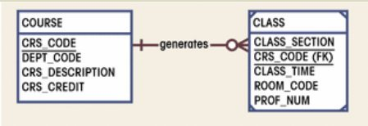
Relationship Strengths
weak relationship
strong relationship
Database Systems: Design, Implementation, & Management: Rob & Coronel
Crow’s Foot model
  Dashed relationship line to indicate weak relationship.
  Solid relationship line & “clipped” corners to indicate strong relationship.
    Double-walled entity in Chen’s model
Database designer often determine the nature of relationship.
  Best suited for database transaction, efficiency, and information requirements
  Based on business rules
S511 Session 5, IU-SLIS

Slide 13
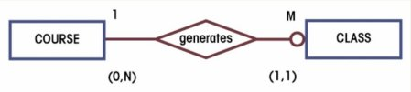

Relationship Participation
Optional Participation
  Entity occurrence does not require a corresponding occurrence in related entity.
    e.g. COURSE generates CLASS (some course may not generate a class)
  Minimum cardinality of the optional entity is 0.
Mandatory Participation
  Entity occurrence requires corresponding occurrence in related entity.
    e.g. COURSE generates CLASS (each course generates one or more classes)
  Minimum cardinality of the mandatory entity is 1.
CLASS is optional to COURSE
CLASS is mandatory to COURSE
Database Systems: Design, Implementation, & Management: Rob & Coronel
S511 Session 5, IU-SLIS

Slide 14
Relationship: Strength vs. Participation
Relationship Strength
  Depends on the formulation of primary key.
Relationship Participation
  Depends on the business rule.
Examples
  EMPLOYEE has DEPENDENT
    Strong & Optional
    A dependent cannot exist without an employee
      DEPENDENT is existence-dependent on EMPLOYEE
    An employee may not have a dependent
      DEPENDENT is optional to EMPLOYEE
  PHD_STUDENT teaches CLASS
    Weak & Mandatory
    A class can exist without a doctoral student
      CLASS is existence-independent on PHD_STUDENT
    A doctoral student must teach at least one class
      CLASS is mandatory to PHD_STUDENT
S511 Session 5, IU-SLIS

Slide 15
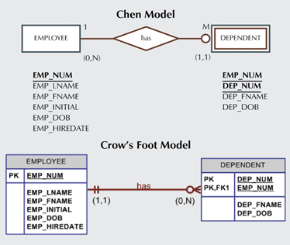
Relationship: Weak Entities
Database Systems: Design, Implementation, & Management: Rob & Coronel
Strong vs. Weak entities
  Strong Entity = existence-independent entity
  Weak Entity
    existence-dependent entity in a strong relationship
    inherits all or part of its primary key from parent entity
    entity w/ clipped corners in CF model, double-walled in Chen model
S511 Session 5, IU-SLIS

Slide 16
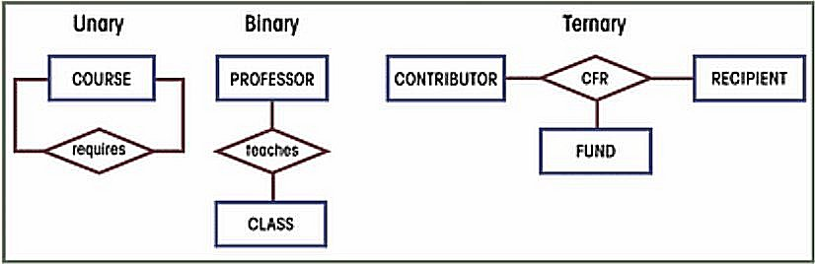
Relationship Degree
Relationship Degree indicates the number of associated entities.
Unary Relationship
  Relationship exists between occurrences of same entity set
  e.g., Recursive relationship
Binary Relationship
  Two entities associated
  Most common
    higher-order relationships are often decomposed into binary relationships
Ternary
  Three entities associated
  e.g., CONTRIBUTOR, RECIPIENT, FUND
    need ternary relationship for a recipient to identify the source of fund
Database Systems: Design, Implementation, & Management: Rob & Coronel
S511 Session 5, IU-SLIS
Notes:
Unary
- a course is a prerequisite for another course (M:N)
Ternary
- CONTRIBUTOR donate money to research FUND (M:N)
- RECIPIENT researchers are funded $ from FUND (M:N)

Slide 17
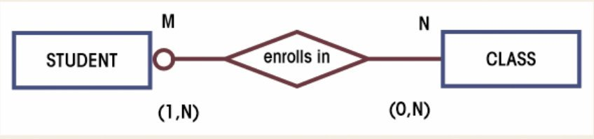
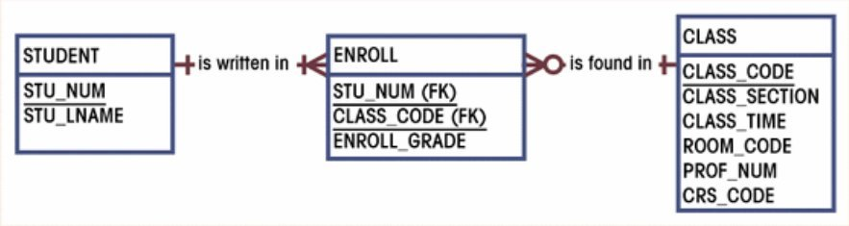
Composite Entities
Composite Entity (i.e., Bridge Entity)
  Transforms a M:N relationship into two 1:M relationships
  Contains primary keys of the “bridged” entities
    May also contain additional attributes that play no role in connective process
  Typically has strong relationships with the “bridged” entities
Database Systems: Design, Implementation, & Management: Rob & Coronel
S511 Session 5, IU-SLIS

Slide 18
M:N to 1:M Conversion
STUDENT
CLASS
STU_ID | STU_NAME | CLS_ID
1234 | John Doe | 10012
1234 | John Doe | 10014
2341 | Jane Doe | 10013
2341 | Jane Doe | 10014
2341 | Jane Doe | 10023
CLS_ID | CRS_NAME | CLS_SECT | STU_ID
10012 | L546 | 1 | 1234
10013 | L546 | 2 | 2341
10014 | L548 | 1 | 1234
10014 | L548 | 1 | 2341
10023 | L571 | 1 | 2341
STU_ID | STU_NAME
1234 | John Doe
2341 | Jane Doe
CLS_ID | STU_ID | ENR_GRD
10012 | 1234 | B
10013 | 2341 | A
10014 | 1234 | C
10014 | 2341 | A
10023 | 2341 | A
CLS_ID | CRS_NAME | CLS_SEC
10012 | L546 | 1
10013 | L546 | 2
10014 | L548 | 1
10023 | L571 | 1
STUDENT
CLASS
ENROLL
Move the foreign key columns to create a bridge table & add attributes if needed.
Collapse the duplicate records in remaining tables.
S511 Session 5, IU-SLIS

Slide 19
Entity Supertypes & Subtypes
Problem:
  Unshared characteristics of certain entity subtypes
    e.g. PILOT vs. EMPLOYEE
Solution:
  Generalization hierarchy
    higher-level Supertype (parent) and lower-level Subtype (child) entities
    Supertype and Subtype maintain 1:1 relationship
    Supertype
      has shared attributes
    Subtypes
      have unique attributes
      inherit attributes and relationships of the supertype
      often comprise of unique and disjoint entities (‘G’ symbol)
        e.g. EMPLOYEE  PILOT, MECHANIC, ACCOUNTANT
      sometimes comprise of overlapping entities (‘Gs’ symbol)
        e.g. EMPLOYEE  PROFESSOR, ADMINISTRATOR
S511 Session 5, IU-SLIS

Slide 20
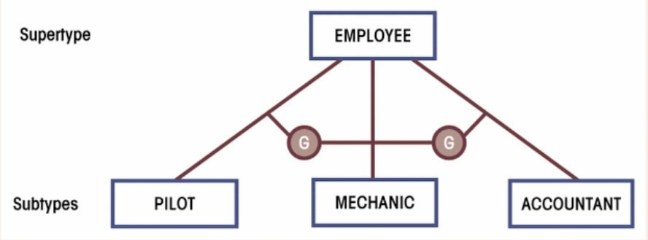
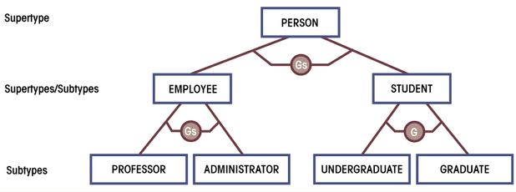
Subtypes: Overlapping vs. Non-overlapping
Non-overlapping (Disjoint)
Overlapping
Database Systems: Design, Implementation, & Management: Rob & Coronel
S511 Session 5, IU-SLIS

Slide 21
Developing ERD
Iterative Process
  Create detailed narrative of organization’s description of operations
  Identify business rules based on description of operations
  Identify main entities and relationships from business rules
  Develop initial ERD
  Identify attributes and primary keys that adequately describe entities
  Revise and review ERD
S511 Session 5, IU-SLIS

Slide 22
ERD Example: Narrative
Narrative of operational environment
  Tiny College is divided into several schools
  Each school is composed of several departments
  Each school is administered by a dean
  Each dean is a member of administrators group
  A dean is also a professor and may teach classes
  Administrators and professors are employees
  Each department offers several courses
  Each course may have several sections (classes)
  Each department has many professors and students
  One of the professors chairs the department
  Each professor may teach up to 4 classes
  A student may enroll in several classes
  Each student has an advisor in his/her department
  Each student belong to only one department
S511 Session 5, IU-SLIS

Slide 23
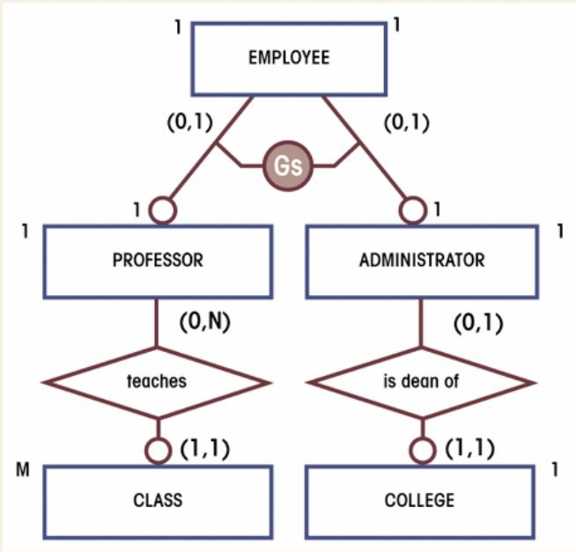

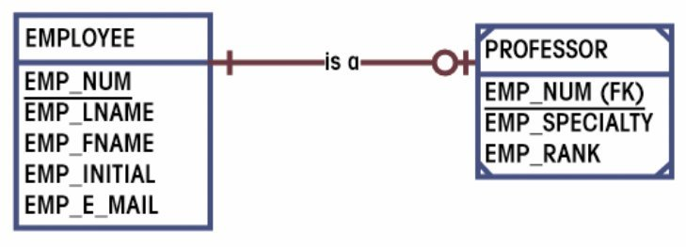
ERD Example: Supertype/Subtype
  - Each school is administered by a dean
  - Each dean is a member of administrators group
  - A dean is also a professor and may teach classes
  - Administrators and professors are employees
Database Systems: Design, Implementation, & Management: Rob & Coronel
Professors and administrators have unique characteristics not present in other employees
  EMPLOYEE supertype, PROFESSOR & ADMINISTRATOR (overlapping) subtypes
Professors and administrators have same set of characteristics
  collapse PROFESSOR and ADMINISTRATOR entities
S511 Session 5, IU-SLIS

Slide 24
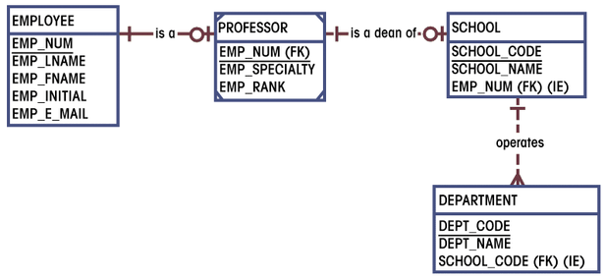
ERD Example: ERD segment 1
Database Systems: Design, Implementation, & Management: Rob & Coronel
  Professors are employees
  A professor may be a dean
  Each school is administered by a dean
  Each school is composed of several departments
S511 Session 5, IU-SLIS

Slide 25
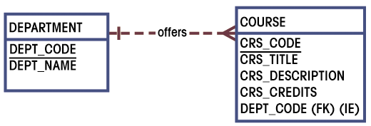
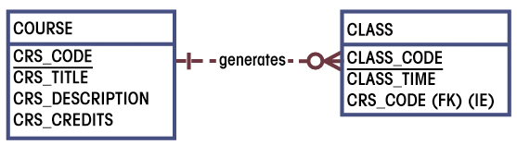
ERD Example: ERD segment 2 & 3
Database Systems: Design, Implementation, & Management: Rob & Coronel
  Each department offers several courses
  Each course may have several sections (classes)
S511 Session 5, IU-SLIS

Slide 26
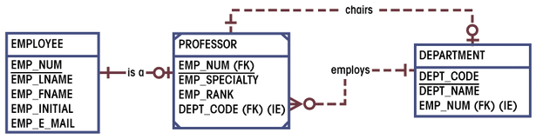
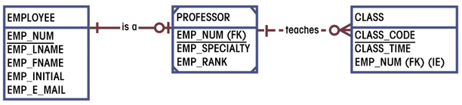
ERD Example: ERD segment 4 & 5
Database Systems: Design, Implementation, & Management: Rob & Coronel
  Each department has many professors
  One of the professors chairs the department
  Each professor may teach up to 4 classes
S511 Session 5, IU-SLIS

Slide 27
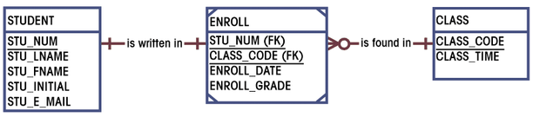
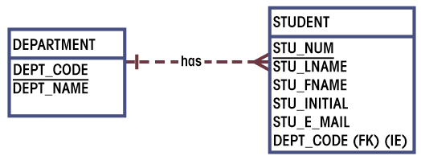
ERD Example: ERD segment 6 & 7
Database Systems: Design, Implementation, & Management: Rob & Coronel
  A student may enroll in several classes
  Each department has many students
  Each student belong to only one department
S511 Session 5, IU-SLIS

Slide 28
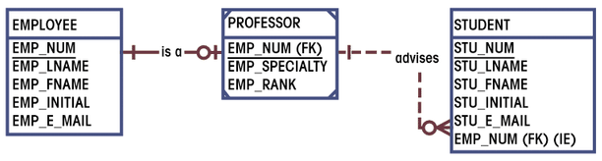
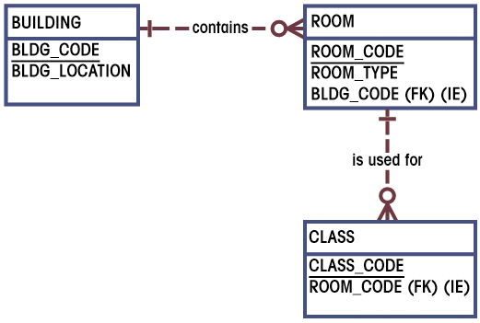
ERD Example: ERD segment 8 & 9
Database Systems: Design, Implementation, & Management: Rob & Coronel
  Each student has an advisor
  Class is held in class rooms
S511 Session 5, IU-SLIS

Slide 29
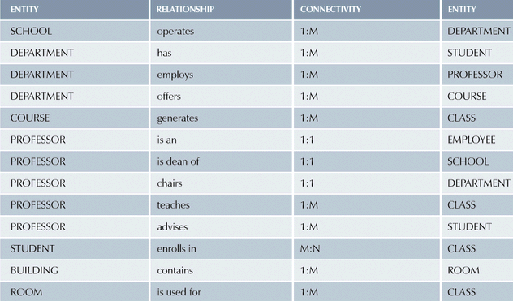
ERD Example: ERD components
Database Systems: Design, Implementation, & Management: Rob & Coronel
S511 Session 5, IU-SLIS

Slide 30
ERD Example: Merging ERD segments
S511 Session 5, IU-SLIS

Slide 31
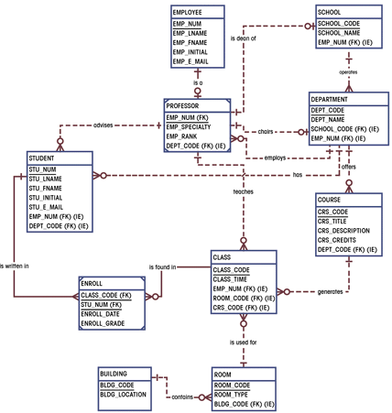
ERD Example: Completed ERD
Database Systems: Design, Implementation, & Management: Rob & Coronel
S511 Session 5, IU-SLIS

Slide 32
Normalization of DB Tables
Normalization
  Process for evaluating and correcting table structures
    determines the optimal assignments of attributes to entities
  Normalization provides micro view of entities
    focuses on characteristics of specific entities
    may yield additional entities
  Works through a series of stages called normal forms
    1NF → 2NF → 3NF → 4NF (optional)
  Higher the normal form, slower the database response
    more joins are required to answer end-user queries
Why normalize?
  Reduce uncontrolled data redundancies
    Help eliminate data anomalies
  Produce controlled redundancies to link tables
S511 Session 5, IU-SLIS

Slide 33
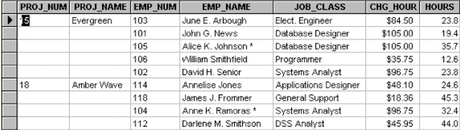
Example: Need for Normalization
PRO_NUM is intended to be primary key but contain nulls
Table entries invite data inconsistencies
  e.g. “Elect. Engineer”, “Elect.Eng.”, “EE”
Table displays data redundancies that can cause data anomalies
  Update anomalies
    Modifying JOB_CLASS could require many alterations (all the rows for the same EMP_NUM)
  Insertion anomalies
    New employee must be assigned a project
  Deletion anomalies
    If employee quits and a row deleted, other vital data may get lost
Database Systems: Design, Implementation, & Management: Rob & Coronel
S511 Session 5, IU-SLIS

Slide 34
Normalization: First Normal Form
First Normal Form (1NF)
  All the primary key attributes are defined
  There are no repeating groups
  All attributes are dependent on the primary key
Conversion to 1NF
  Objective
    Develop a proper primary key
  Steps
    Eliminate repeating groups
      fill in the null cells with appropriate data value
    Identify primary key
      identify attribute(s) that uniquely identifies each row
    Identify all dependencies
      make sure all attributes are dependent on the primary key
S511 Session 5, IU-SLIS

Slide 35
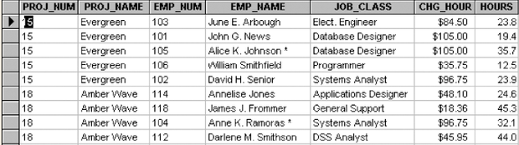
Normalization: 1NF example
Eliminate repeating groups - Fill in the null cells to make each row define a single entity
Identify the primary key - Make sure all attributes are dependent on the primary key
Database Systems: Design, Implementation, & Management: Rob & Coronel
S511 Session 5, IU-SLIS

Slide 36
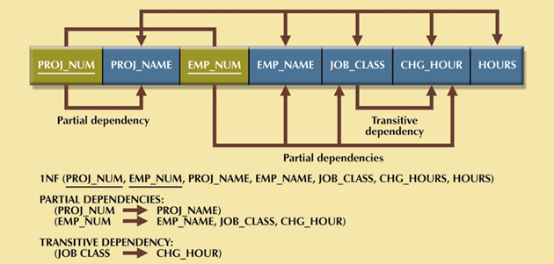
Normalization: 1NF example
Identify all dependencies (in a Dependency Table)
  Desirable dependencies (arrows above)
    based on primary key (functional dependency)
  Less desirable dependencies (arrows below)
    Partial dependency
      based on part of composite primary key
    Transitive dependency
      one nonprime attribute depends on another nonprime attribute
    Subject to data redundancies and anomalies
Database Systems: Design, Implementation, & Management: Rob & Coronel
S511 Session 5, IU-SLIS

Slide 37
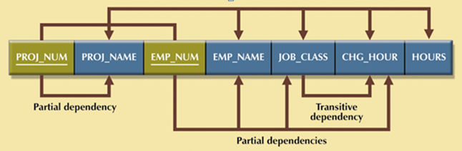
Normalization: Second Normal Form
Second Normal Form (2NF)
  It is in 1NF
  There are no partial dependencies
Conversion to 2NF
  Objective
    Eliminate partial dependencies
  Steps
    Start with 1NF format
    Write each key component (w/ partial dependency) on separate line
    Write original (composite) key on last line
    Each component is new table
    Write dependent attributes after each key
    1NF (PROJ_NUM, EMP_NUM, PROJ_NAME, EMP_NAME, JOB_CLASS, CHG_HOUR, HOURS)
    ↓
    PROJECT (PROJ_NUM, PROJ_NAME)
    EMPLOYEE (EMP_NUM, EMP_NAME, JOB_CLASS, CHG_HOUR)
    ASSIGN (PROJ_NUM, EMP_NUM, HOURS)
S511 Session 5, IU-SLIS

Slide 38
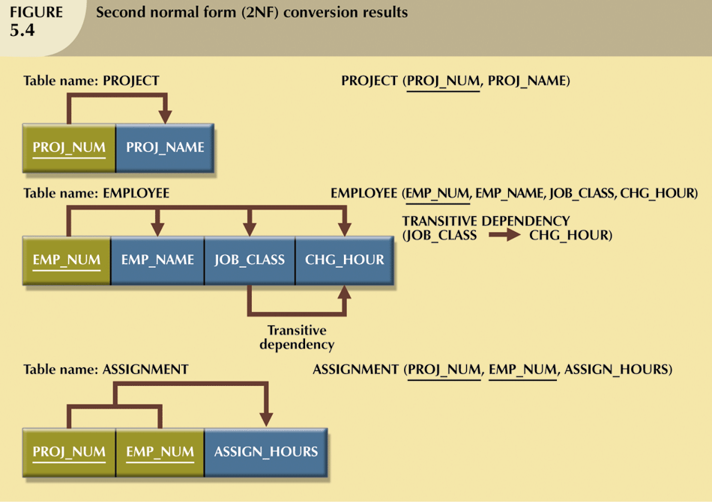
Normalization: 2NF example
Database Systems: Design, Implementation, & Management: Rob & Coronel
S511 Session 5, IU-SLIS

Slide 39
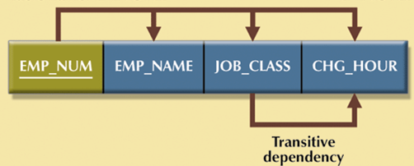
Normalization: Third Normal Form
Third Normal Form (3NF)
  It is in 2NF
  There are no transitive dependencies
Conversion to 3NF
  Objective
    Eliminate transitive dependencies (TP)
  Steps
    Start with 2NF format
    Break off the TP pieces and create separate tables
    EMPLOYEE (EMP_NUM, EMP_NAME, JOB_CLASS, CHG_HOUR)
    ↓
    EMPLOYEE (EMP_NUM, EMP_NAME, JOB_CLASS)
    JOB (JOB_CLASS, CHG_HOUR)
S511 Session 5, IU-SLIS

Slide 40
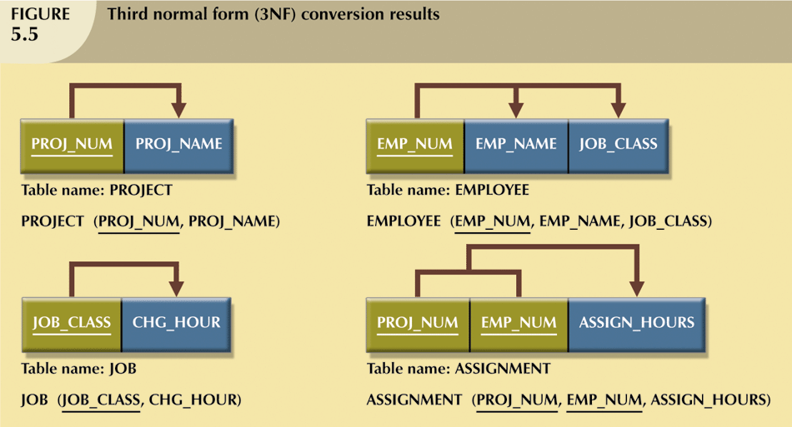
Normalization: 3NF example
Database Systems: Design, Implementation, & Management: Rob & Coronel
S511 Session 5, IU-SLIS

Slide 41
Normalization: Fourth Normal Form
Forth Normal Form (4NF)
  It is in 3NF
  There are no multiple sets of independent multi-valued dependencies
  Infrequently needed
    e.g. COURSE has multiple texts and multiple instructors
    (texts for a course are not decided by instructor)
Conversion to 4NF
    Identify multiple multi-valued attributes
    Create separate tables containing each of multi-valued attributes
COURSE | CRS_TEXT
S511 | DB design
S511 | Inside Access 2007
COURSE | CRS_TEXT | CRS_INSTRUCTOR
S511 | DB design | Jones
S511 | DB design | Smith
S511 | Inside Access 2007 | Jones
S511 | Inside Access 2007 | Smith
COURSE | CRS_INSTRUCTOR
S511 | Jones
S511 | Smith
S511 Session 5, IU-SLIS

Slide 42
Additional Table Enhancement
Adhere to naming conventions
Use transaction code instead of composite primary key when appropriate
  e.g. ASG_NUM in ASSIGN
Use simple attributes
  e.g. EMP_LNAME, EMP_FNAME, EMP_INIT in EMPLOYEE
Add attributes to facilitate information extraction
  e.g. EMP_NUM in PROJECT to indicate project manager
  e.g. ASG_CHG_HR in ASSIGN for historical accuracy of data
Allow data controlled data redundancies
  e.g. ASG_CHG_AMOUNT in ASSIGN (derived attribute)
PROJECT (PROJ_NUM, PROJ_NAME)
JOB (JOB_CLASS, CHG_HOUR)
ASSIGN (PROJ_NUM, EMP_NUM, HOURS)
EMPLOYEE (EMP_NUM, EMP_NAME, JOB_CLASS)
↓
PROJECT (PROJ_NUM, PROJ_NAME, EMP_NUM)
JOB (JOB_CODE, JOB_DESCRIPTION, JOB_CHG_HR)
ASSIGN (ASG_NUM, ASG_DATE, PROJ_NUM, EMP_NUM, ASG_HRS, ASG_CHG_HR, ASG_CHG_AMOUNT)
EMPLOYEE (EMP_NUM, EMP_LNAME, EMP_FNAME, EMP_INIT, EMP_HIREDATE, JOB_CODE)
S511 Session 5, IU-SLIS

Slide 43
Denormalization
Normalization is one of many database design goals.
However, normalized tables result in:
  additional processing
  loss of system speed
When normalization purity is difficult to sustain due to conflict in:
  design efficiency
  information requirements
  processing speed
  Denormalize by
    use of lower normal form
    use of controlled data redundancies
S511 Session 5, IU-SLIS

